Slide 1
Grassroots Arts Program
Final Report Webinar

Slide 2
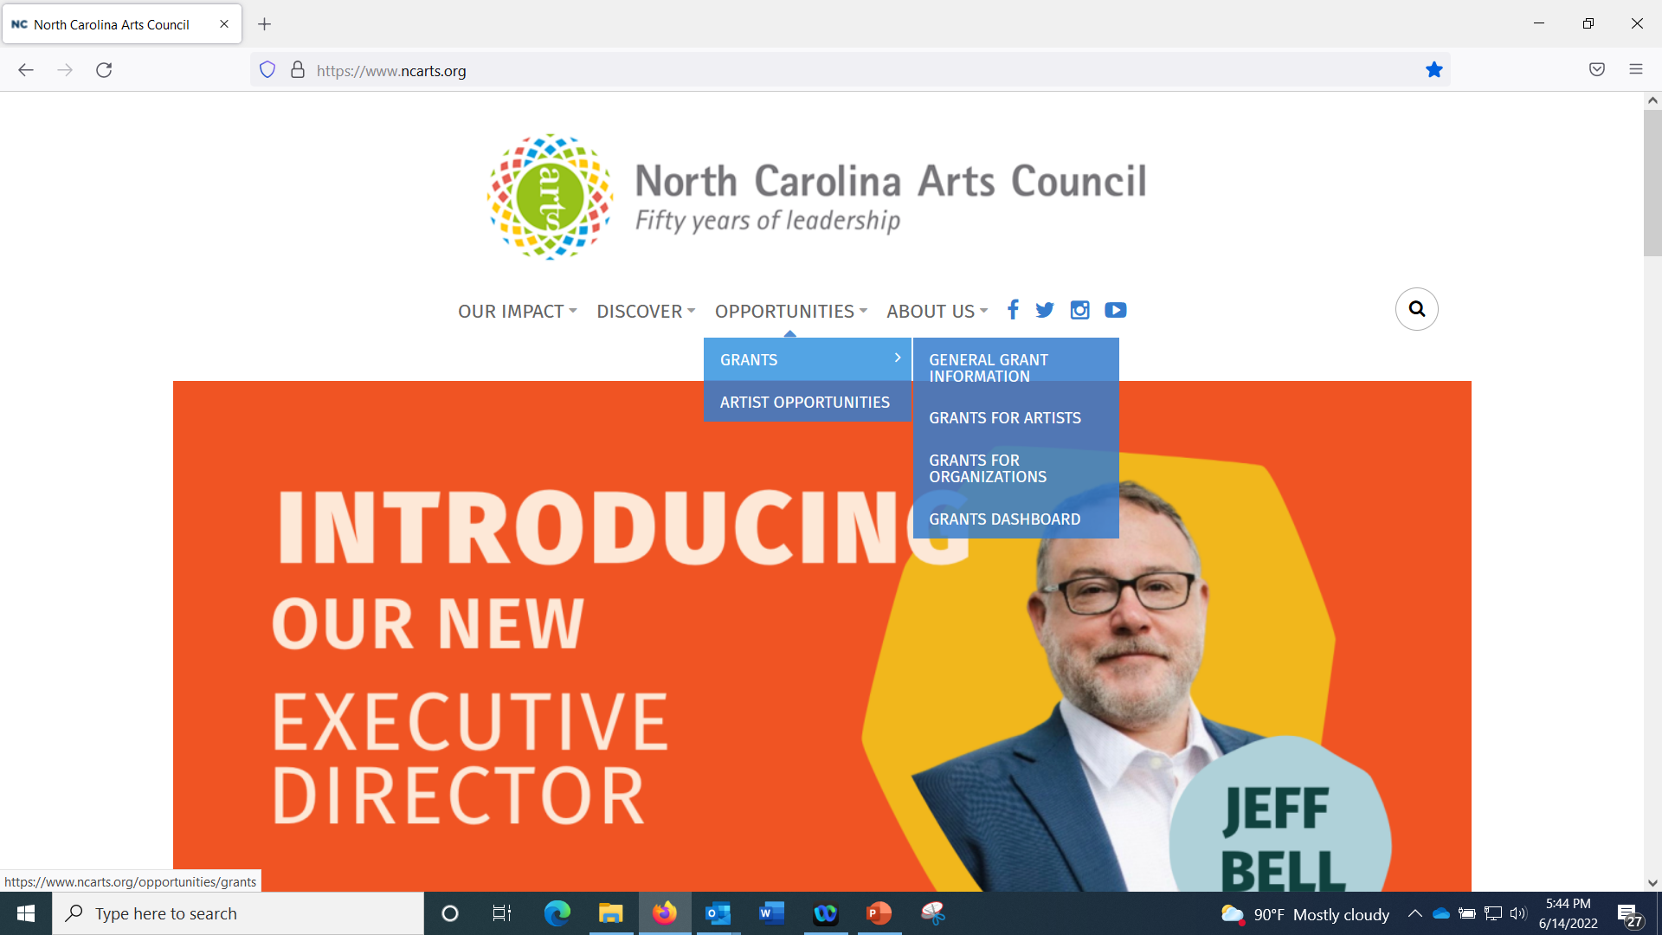
GoSmart
Starting point: https://ncarts.gosmart.org OR you can go to our website, www.ncarts.org and then click on Opportunities Tab, and the drop-down choice of Grants Dashboard

Slide 3
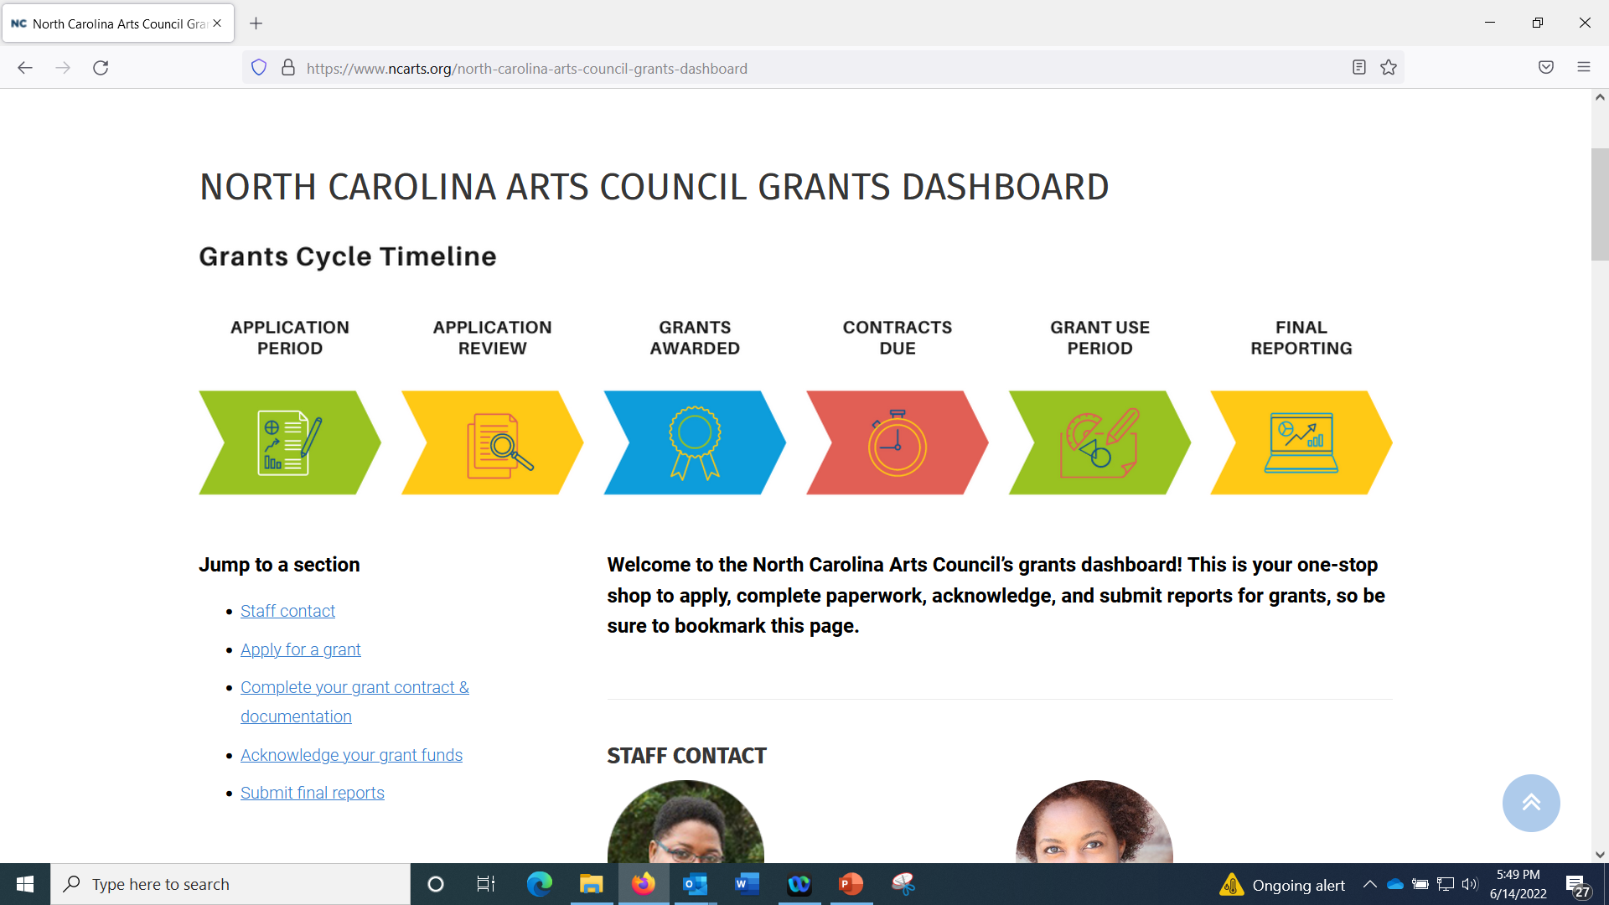

Slide 4
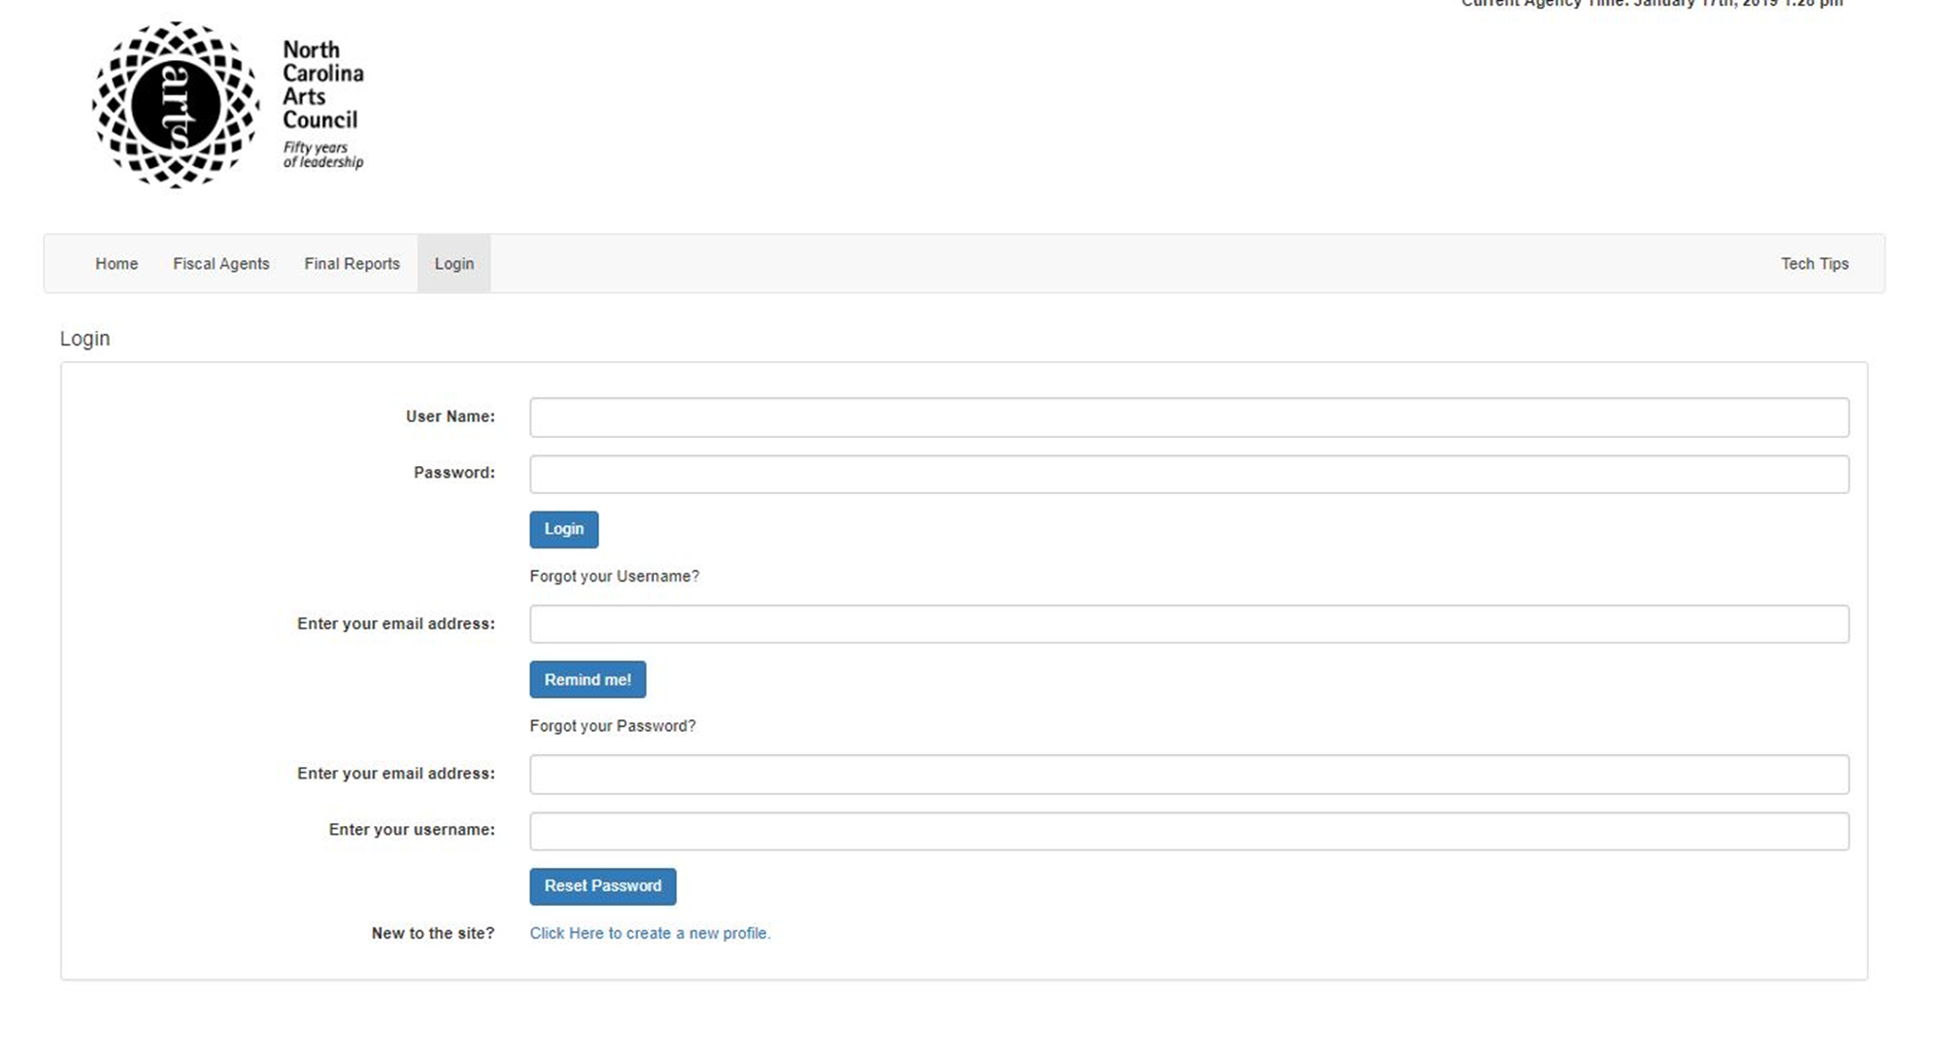
GoSmart
Notes:
- Login now up at the top bar
Options if you have forgotten. You can always call us.

Slide 5
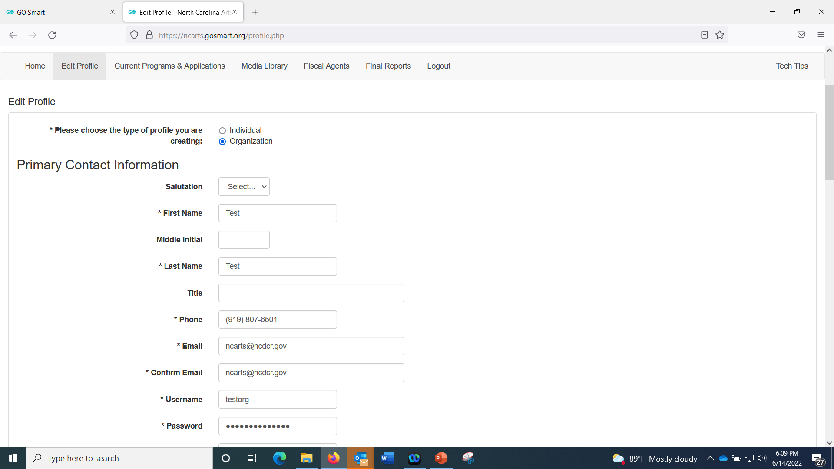
Always review your profile information to make sure we have the right contact for the grant.

Slide 6
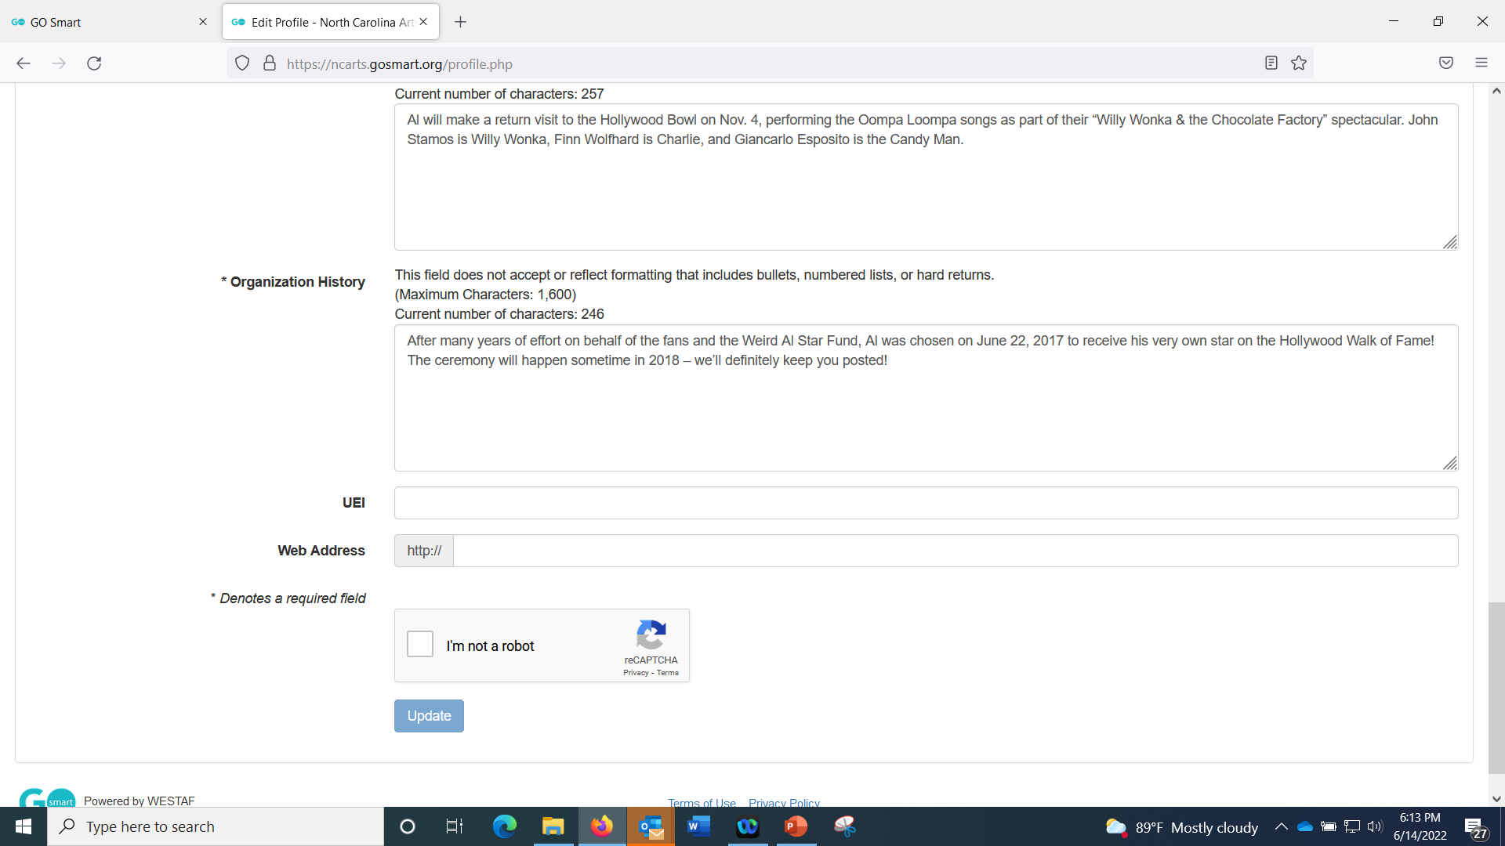
Add your Organization’s UEI number to your profile.

Slide 7
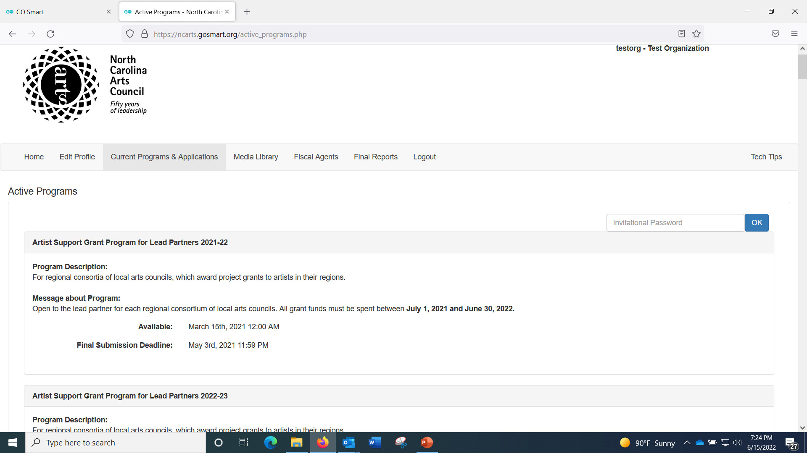

Slide 8
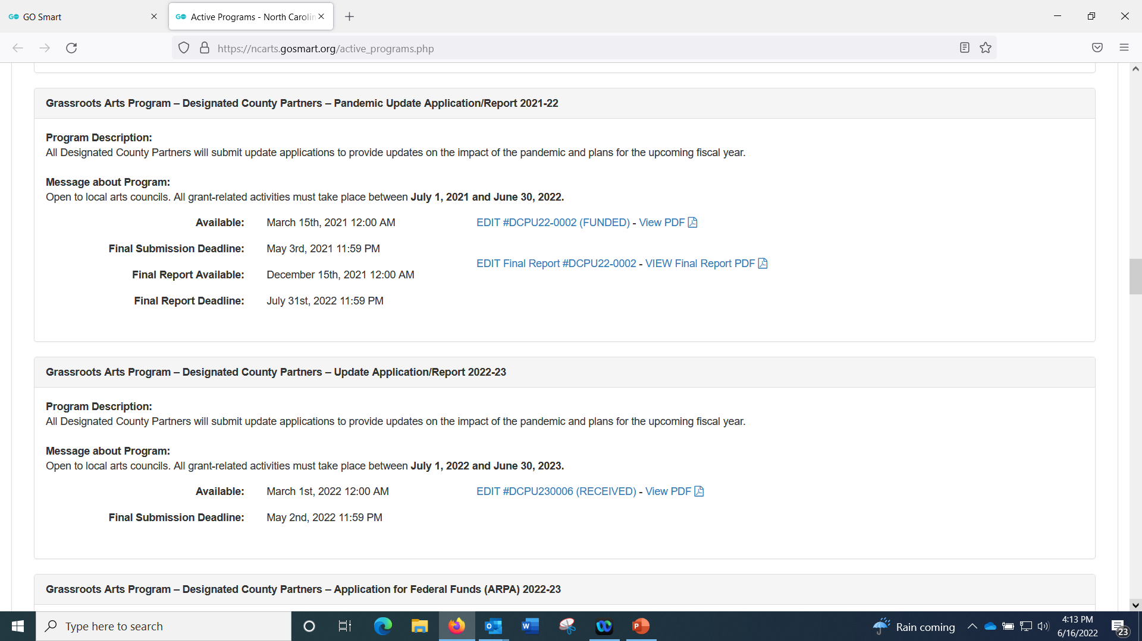
Scroll down until you find Grassroots Arts Program report, whether DCP or PCP for FY2021-22. EDIT Final report will be in Blue.

Slide 9
Final Report

Slide 11
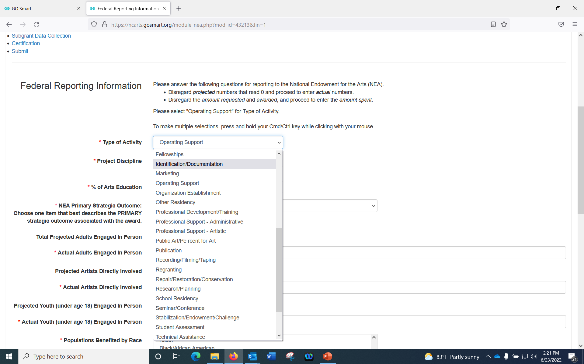
Grassroots School Partners should select Arts Instruction or School Residency.
Notes:
Select Operating Support for Type of , unless you are a School Grassroots partner. In that case, select Art Instruction or School Residency.

Slide 12
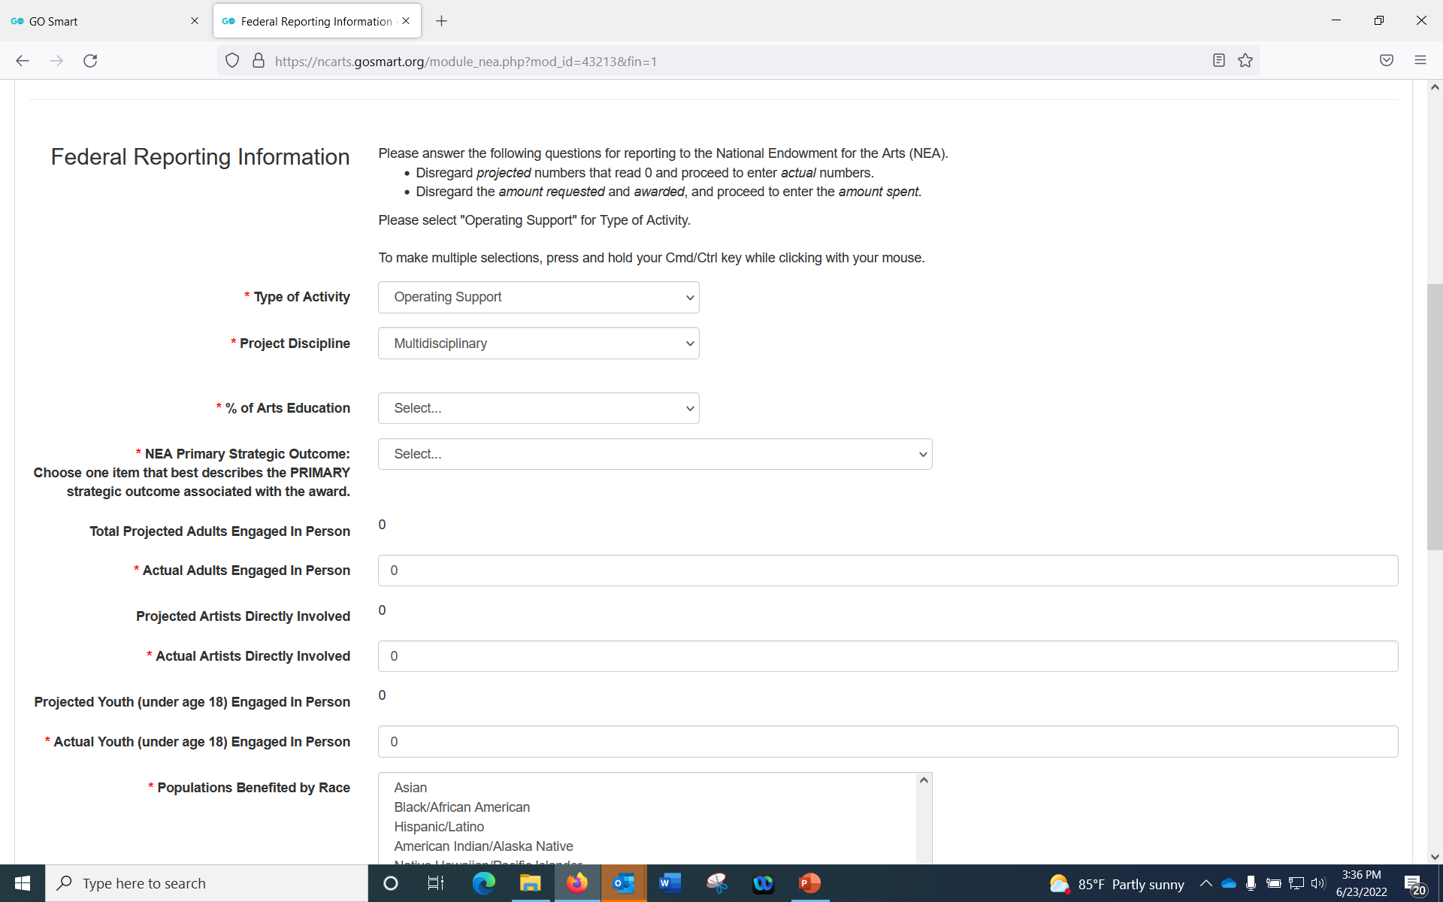
Notes:
Select Multidisciplinary

Slide 13
Notes:
Project Contact Information:
- This is who will receive the contract upon receiving the grant! If you put a different email from the one in your profile, it will override the profile contact and your comprehensive, bulk contract (not just Grassroots) will be emailed to this email. Make note that if you don’t want that to happen, leave it blank.
- If you do happen to have a fiscal agent, you must fill this out with their information so that the fiscal agent receives the paperwork. Do not put any email in here that you don’t want getting all of your contracts from the N.C. Arts Council.
- If you’re a fiscal agent filling this out for someone else, when you do their PCP App, this is where you put your information.

Slide 14
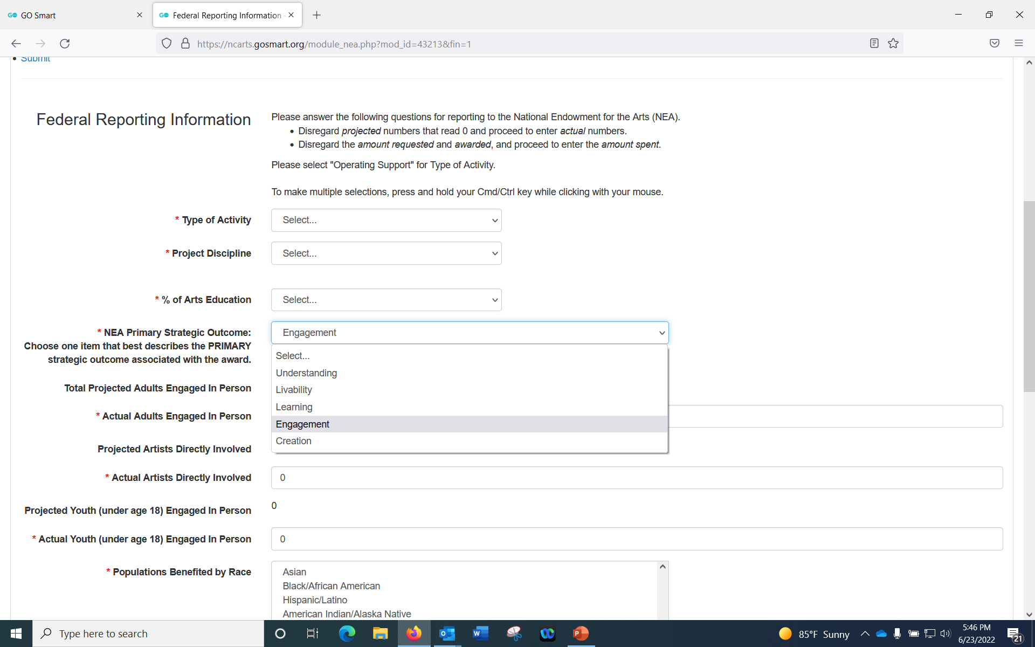
Grassroots School Partners should select Learning

Slide 15
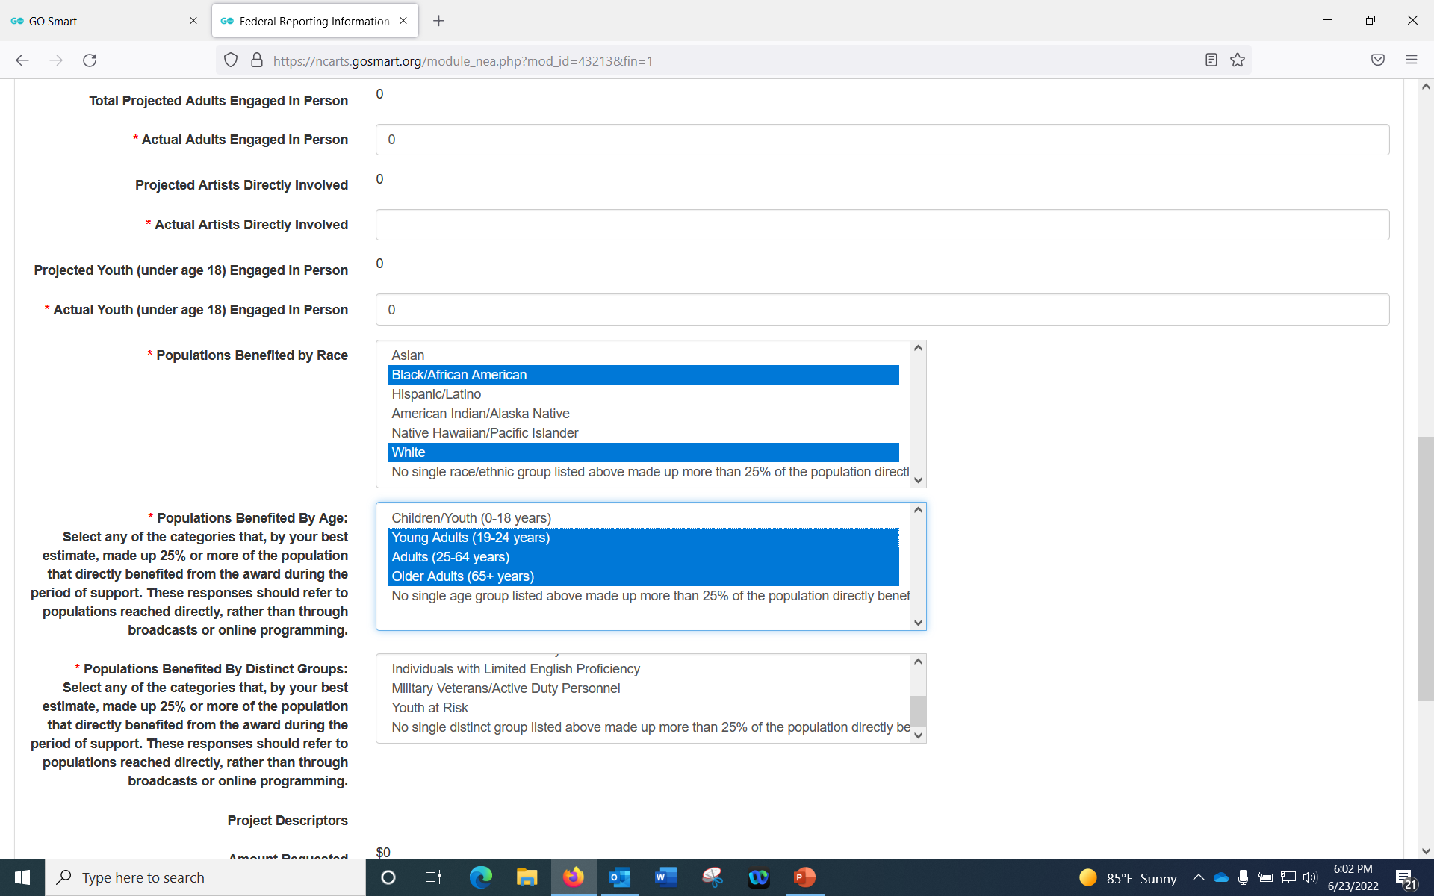
You can choose more than one category by holding down the Control button

Slide 16
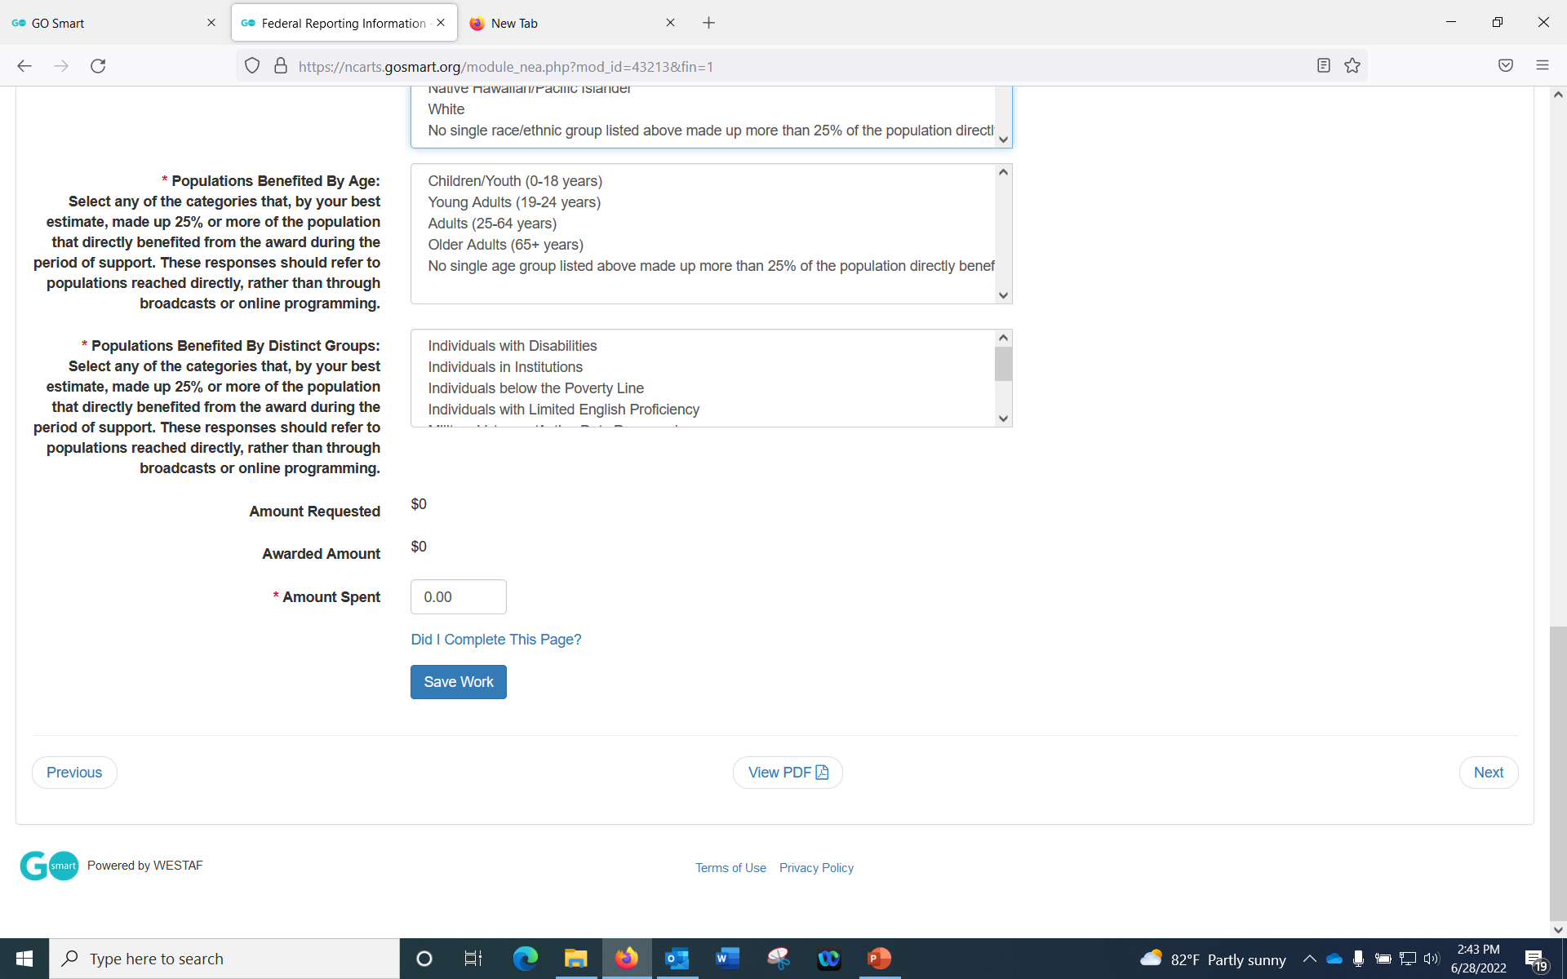
List your Total Grassroots allotment in Amount Spent

Slide 17
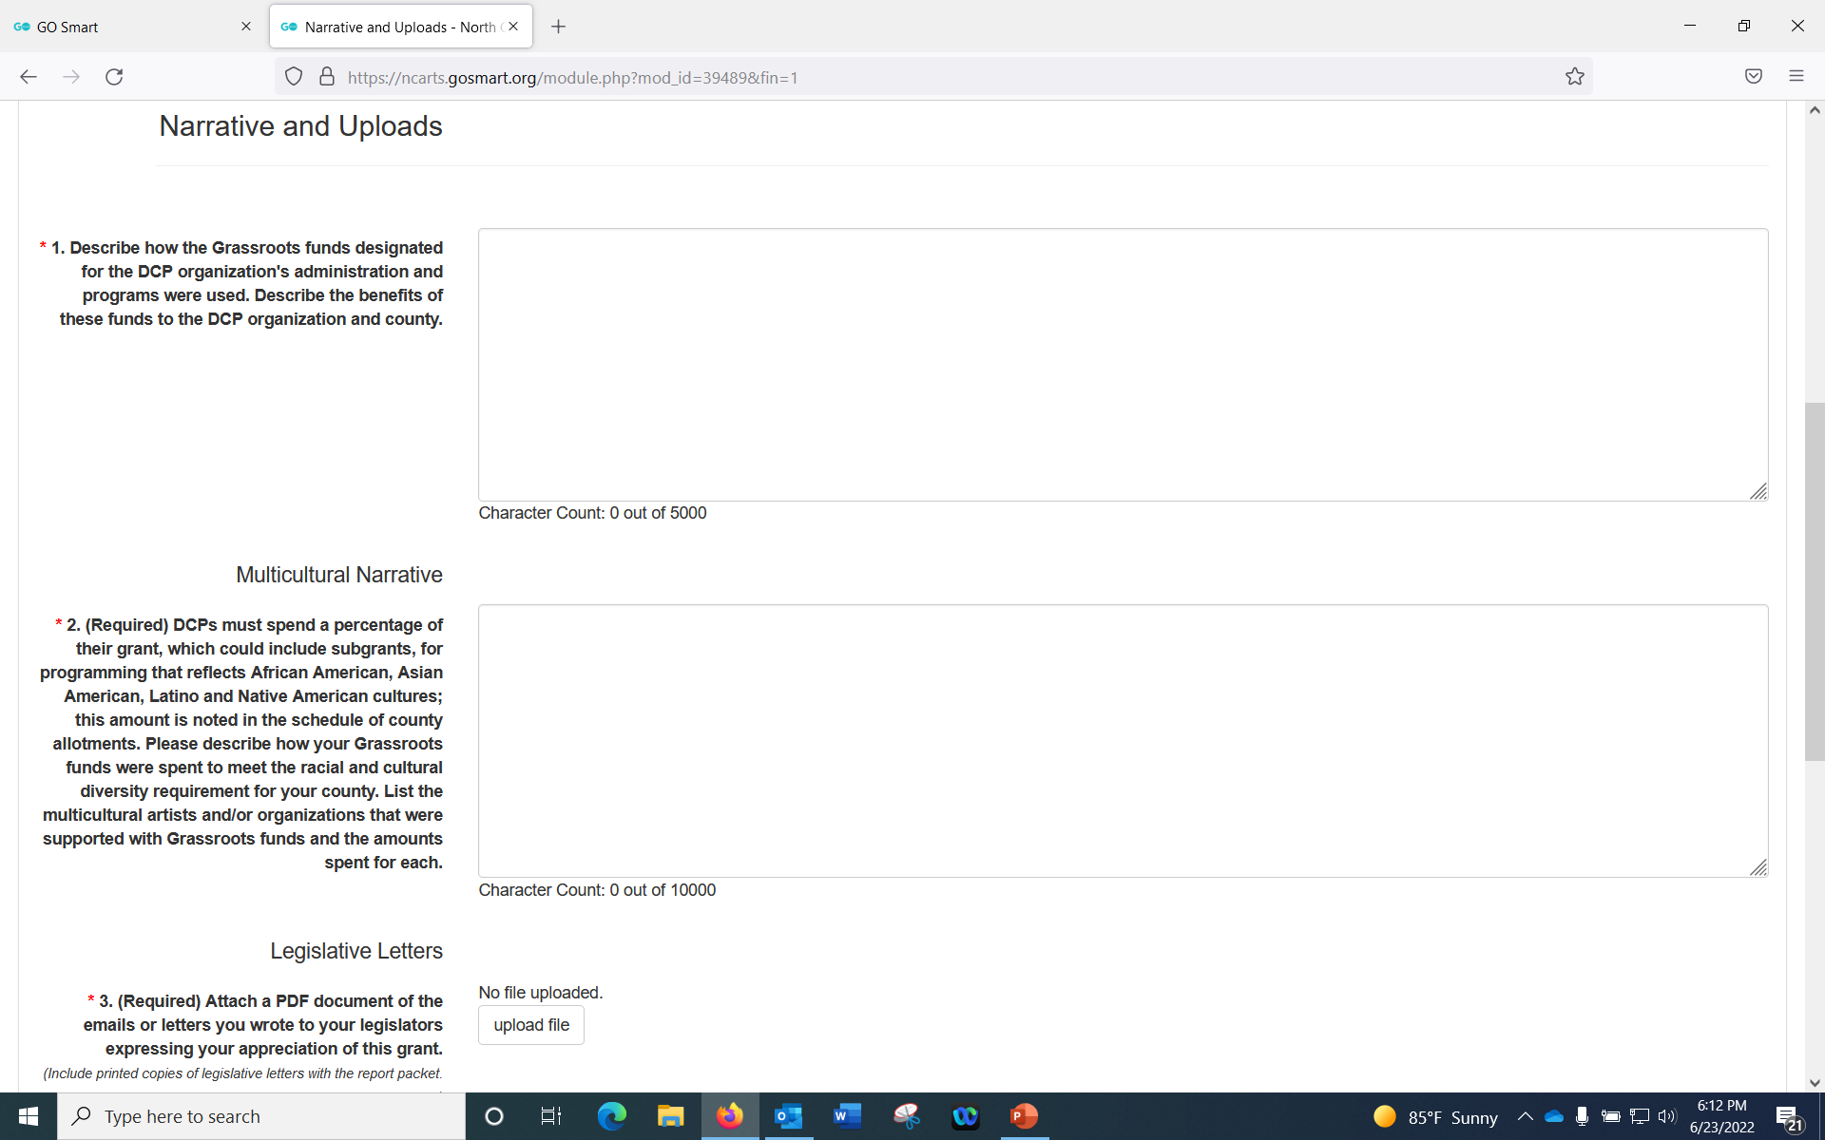
This should be at least one substantial paragraph that describes in detail how the Grassroots funds were used. Describe how the funds impacted the county. For example, numbers from the Department of Tourism, any new strong partnerships formed due to funding.
For your multicultural programming, you can write that the event is explained in detail in the Multicultural narrative below. Do not repeat the narrative in both places.
Refer to the allotment table on the Local Arts Council Resources page for your MC number.
This is one of the only narrative areas where you will describe subgrants – if they are multicultural.
This narrative will include all of your relevant internal programming that demonstrate the support of artists who identify as Asian, Black/African American, Hispanic/Latino, American Indian, or Native Hawaiian/Pacific Islander.

Slide 18
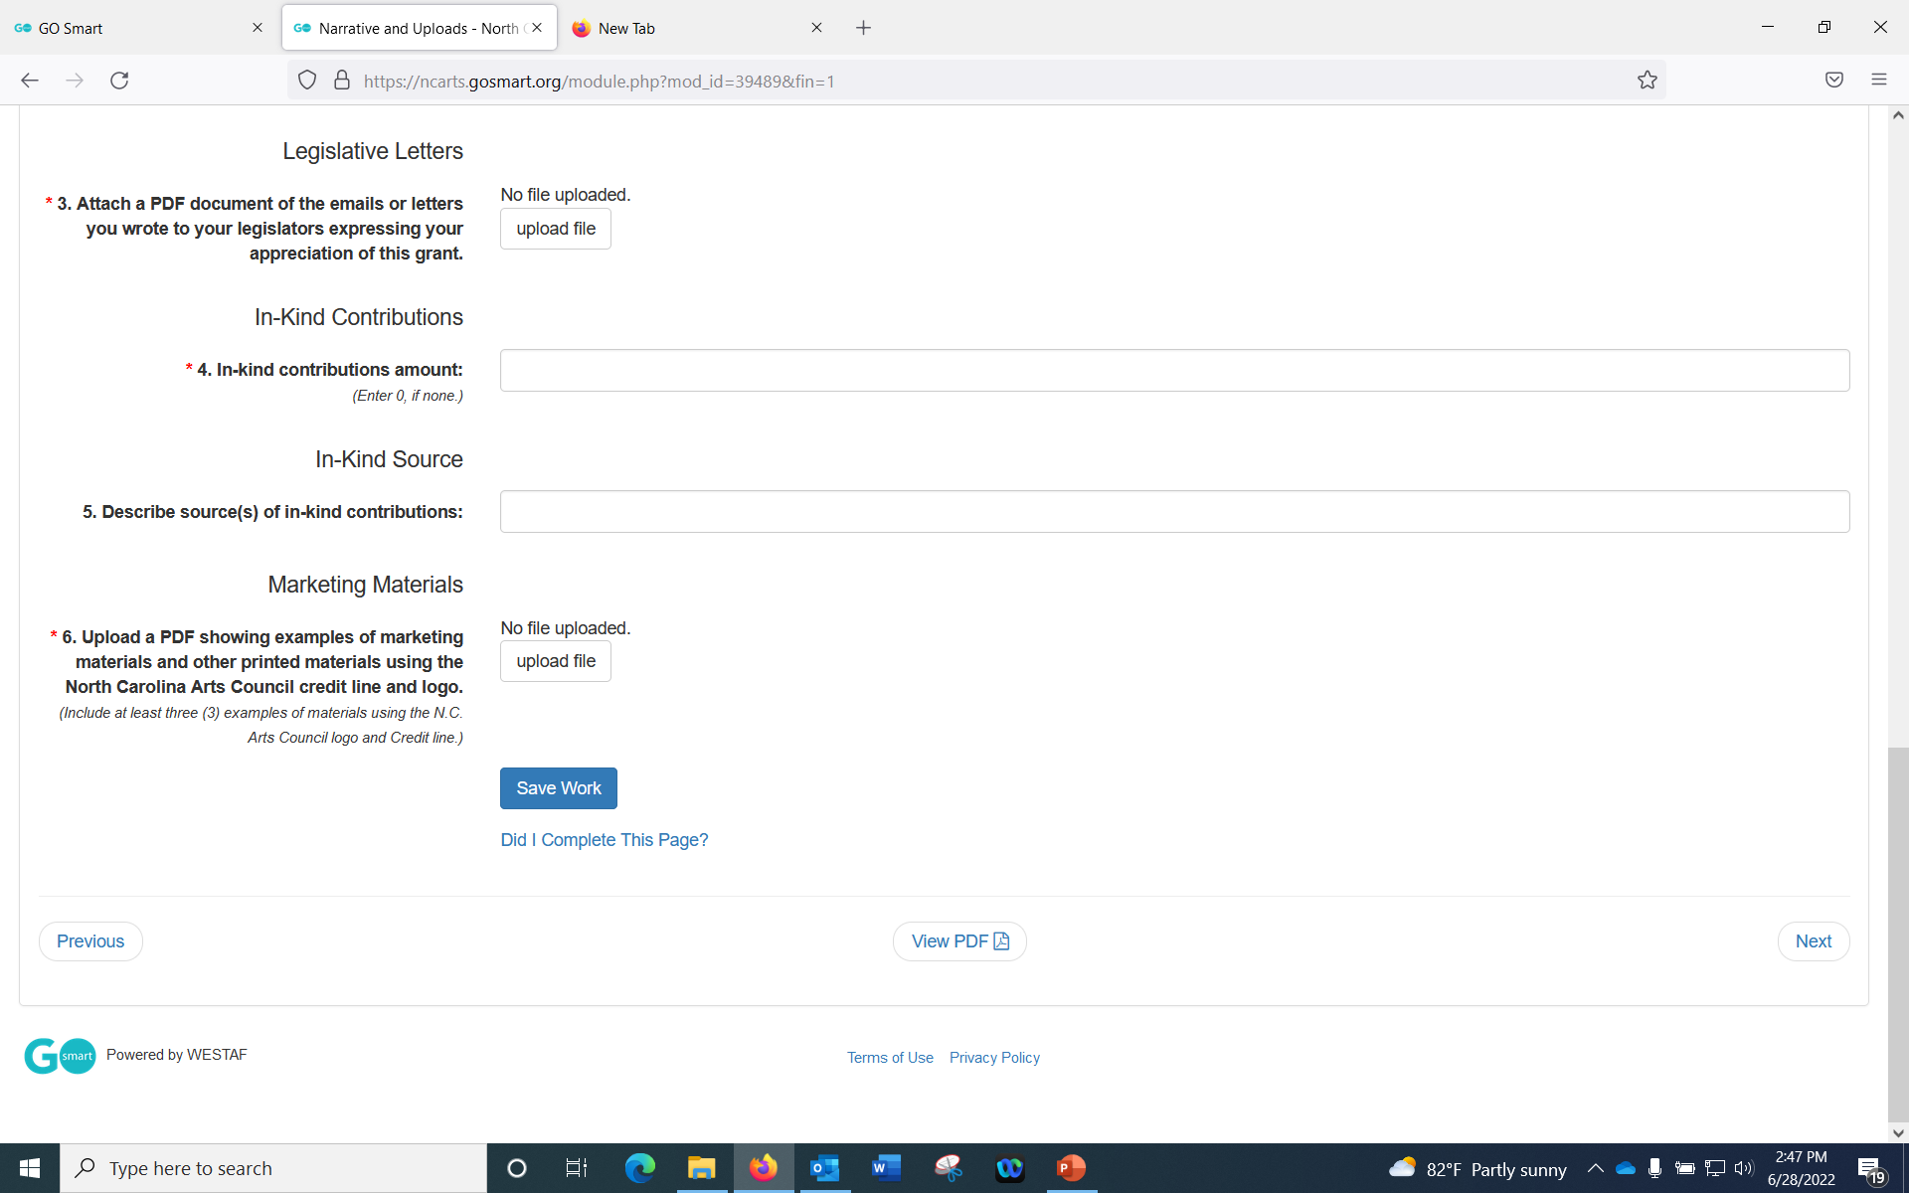

Slide 19
- List each artist with their racial designator in the 1st column and amount of payment in the second column
- Follow the designators listed – they match with the census. Do not add races.
- Please ensure this list matches your narrative. Artists listed here should be mentioned in the narrative and vice versa.

Slide 20
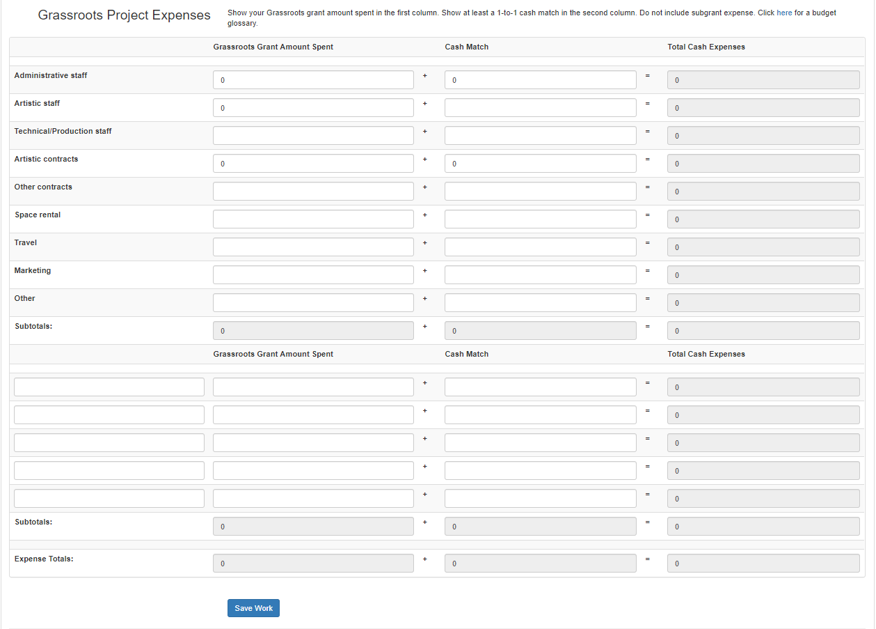
List exactly what Grassroots Grant money and its matching monies went towards.
Cash Match must equal or exceed Grassroots Grant Amount Spent.

Slide 21
Example: Grassroots Grant Amount Spent and Cash Match may not match exactly on the same line item, but the totals do.

Slide 22
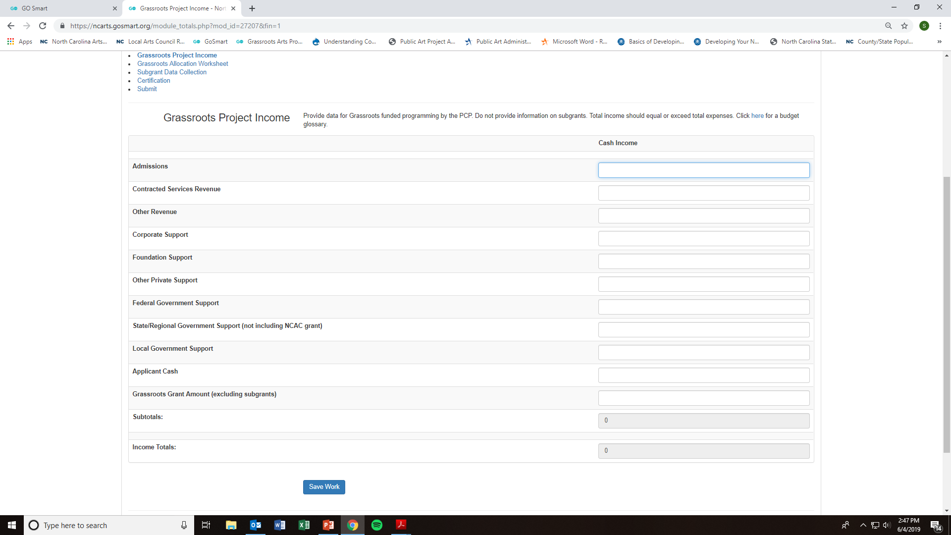
In this section, you will list all sources of income that match the Grassroots Grant.

Slide 23
Grassroots grant amount should match the Grassroots Allocation Chart and the funds listed on the Grassroots Project Expenses page.

Slide 24
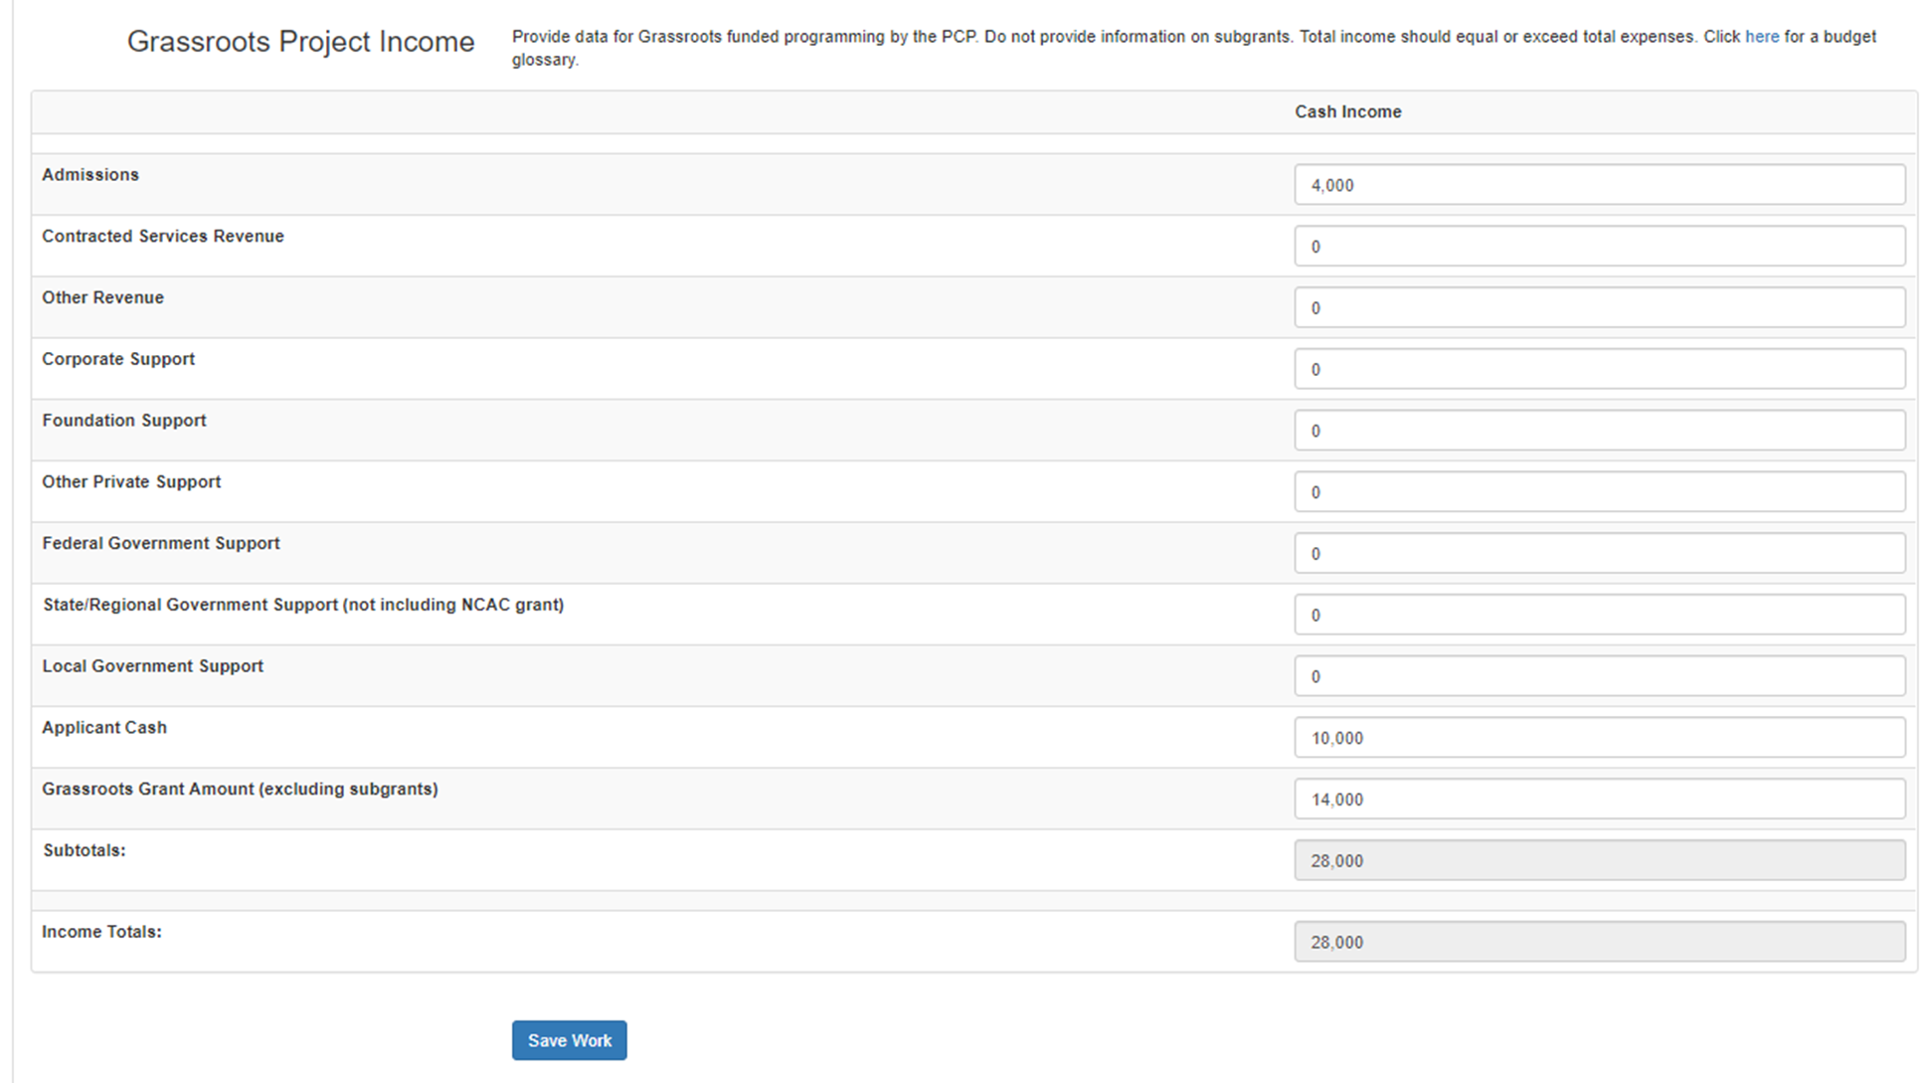
The amounts in this top section should equal or exceed the amount listed in Grassroots Grant Amount. For example:
$14,000
$14,000

Slide 25
Total should match or exceed your total expenses.

Slide 26
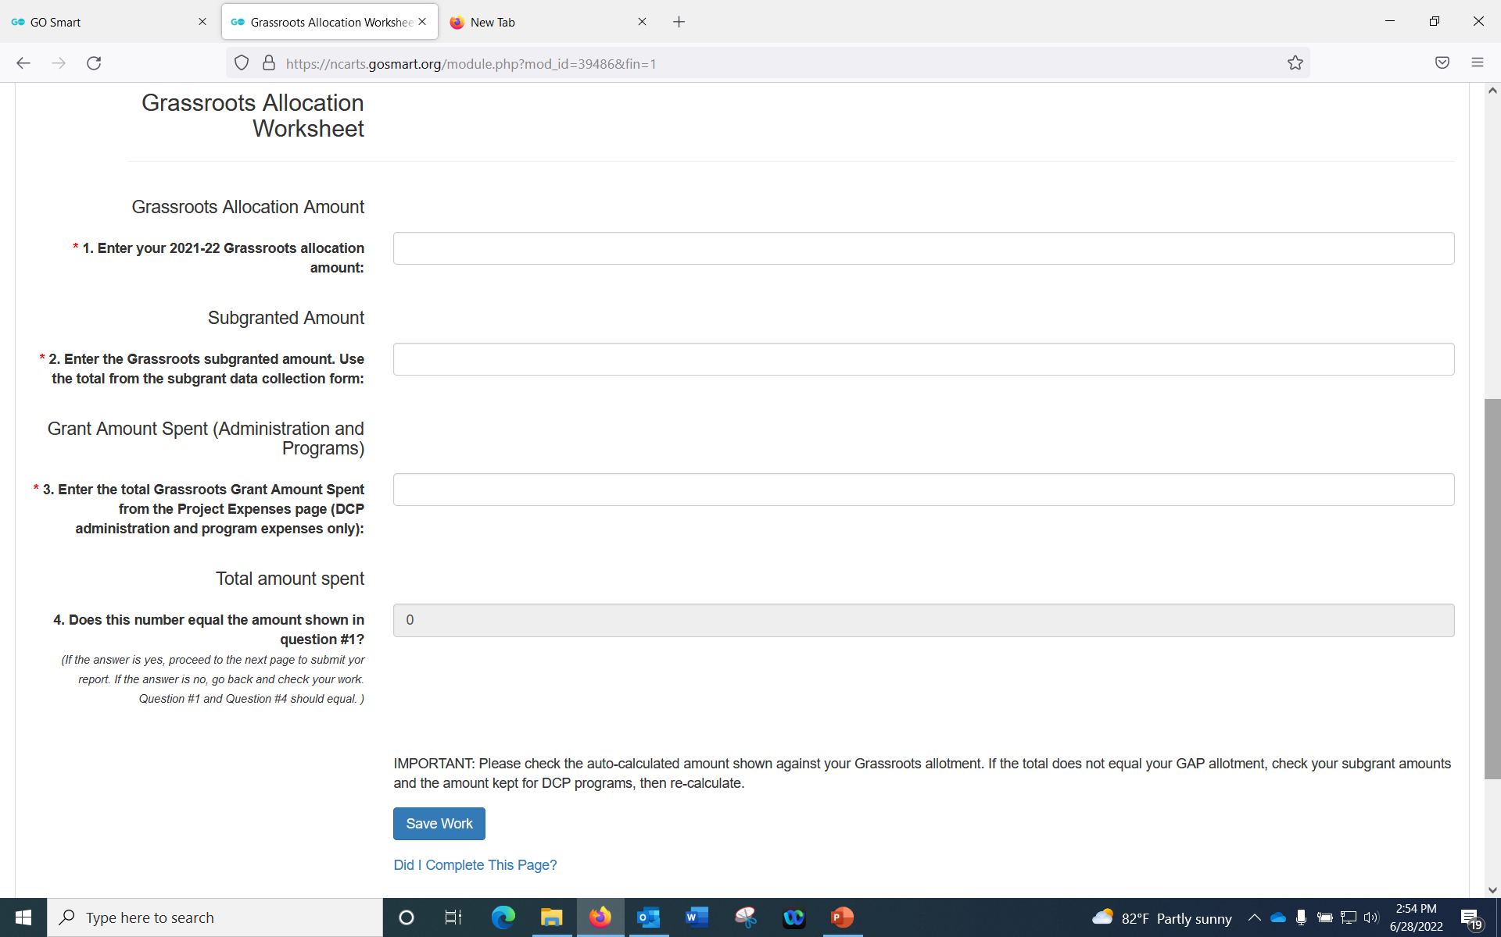
This amount should exactly = what is in the Allotment chart
Subgrants only! This amount should equal what you list in Subgrant Data Collection form
Grant Amount Spent = Grassroots Allocation minus Subgranted Amount
This should equal the total in the Project Expenses

Slide 27
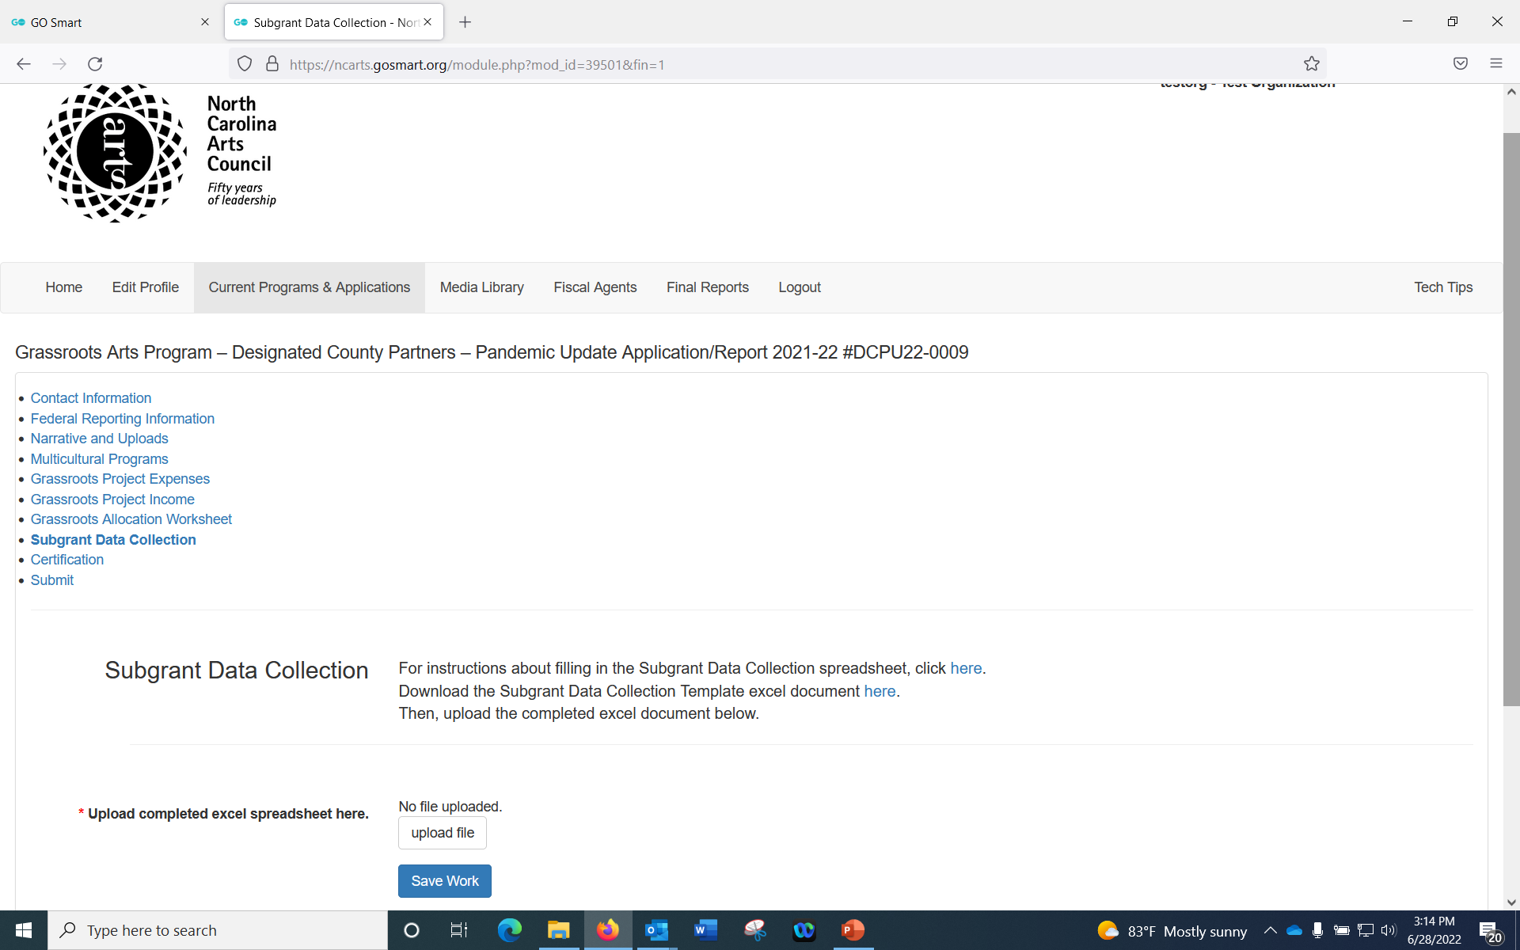
Download the Subgrant Data Collection Form and fill in data for each of your subgrantees.
Then, upload the completed form to the application.
If you did not subgrant, you will upload a blank spreadsheet.

Slide 28
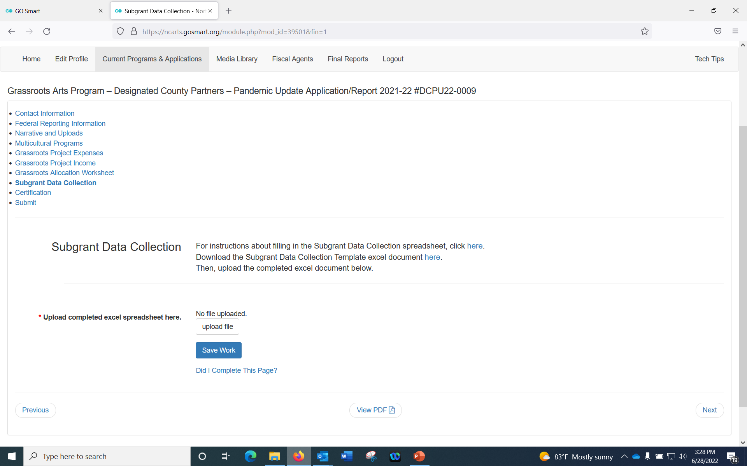
Download step by step instructions if this is your first time filling this out

Slide 29
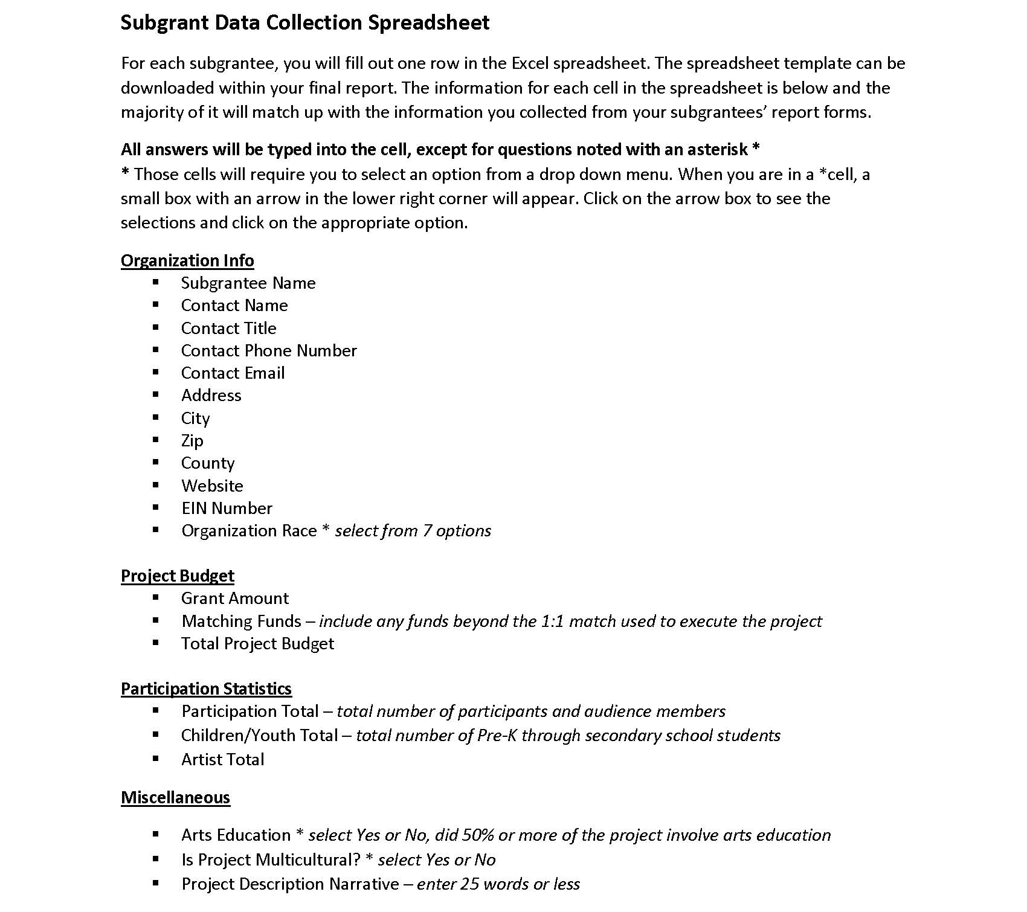
Step-by-step instructions

Slide 30
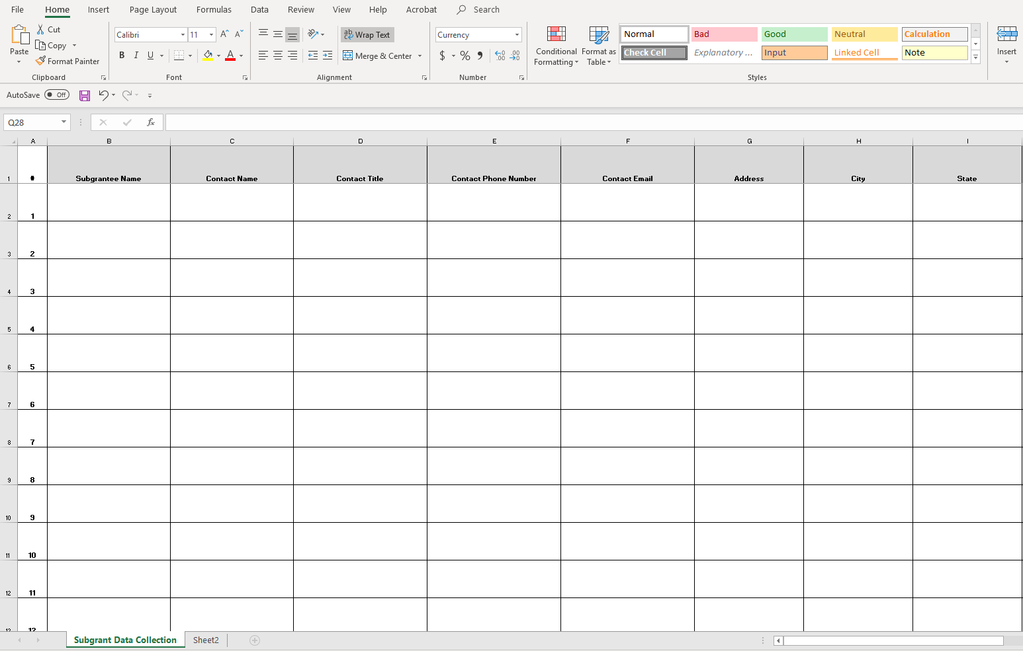
Make sure ALL fields are complete

Slide 31
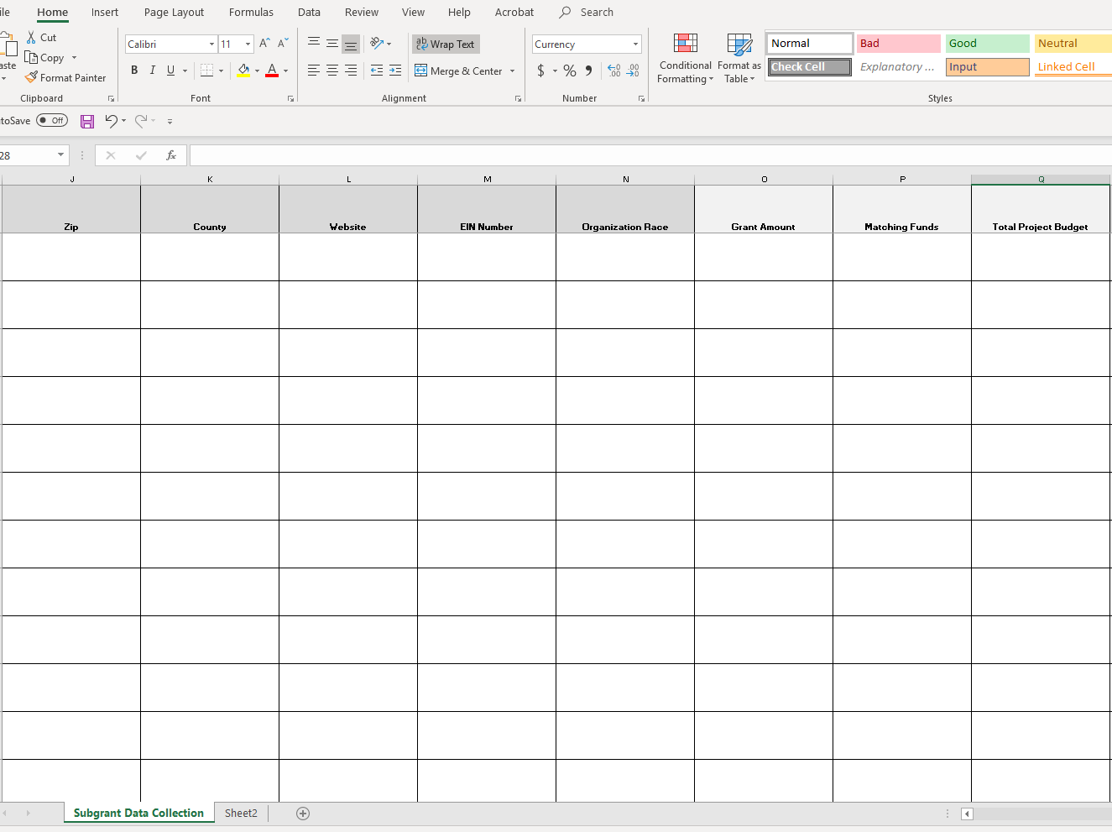
EIN number is REQUIRED. If you do not have one, you will have to call the subgrantee and obtain it.

Slide 32
Organization race pertains to the organization,
not the audience.

Slide 33
Grant Amount + Matching Funds = Total Project Budget.

Slide 34
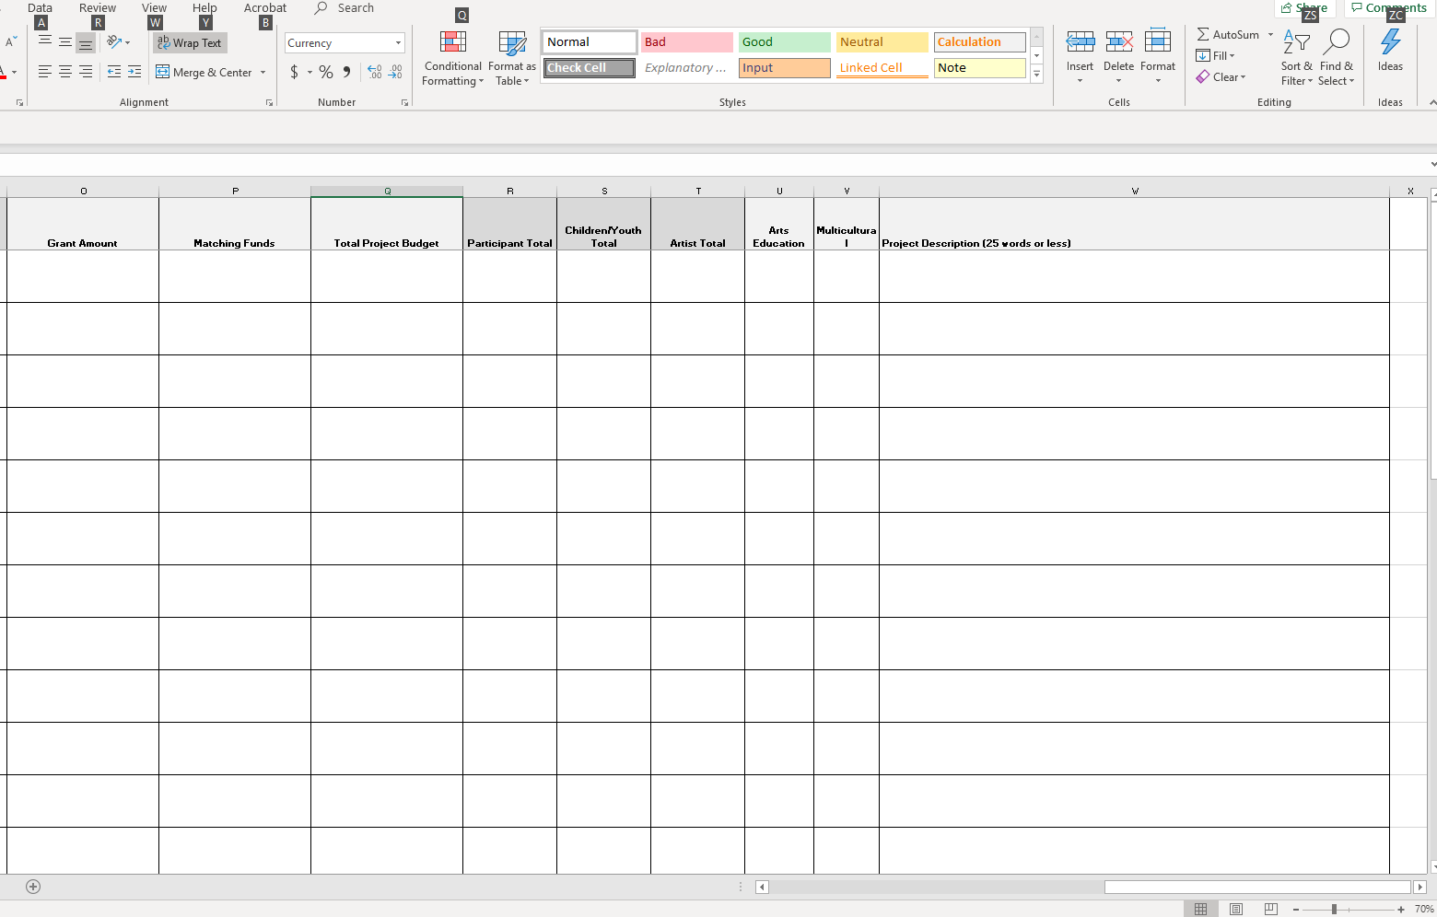
If you select “yes” under Multicultural, it MUST be listed in the corresponding Multicultural section in the Final Report and vice versa.

Slide 35
Keep the project description succinct yet informative. Tell us how the funds were used and give a simple description of the event.

Slide 36
You will find all totals at the bottom of the spreadsheet. Make sure the total grant amount listed in this first cell matches the amount listed in the final report.

Slide 37
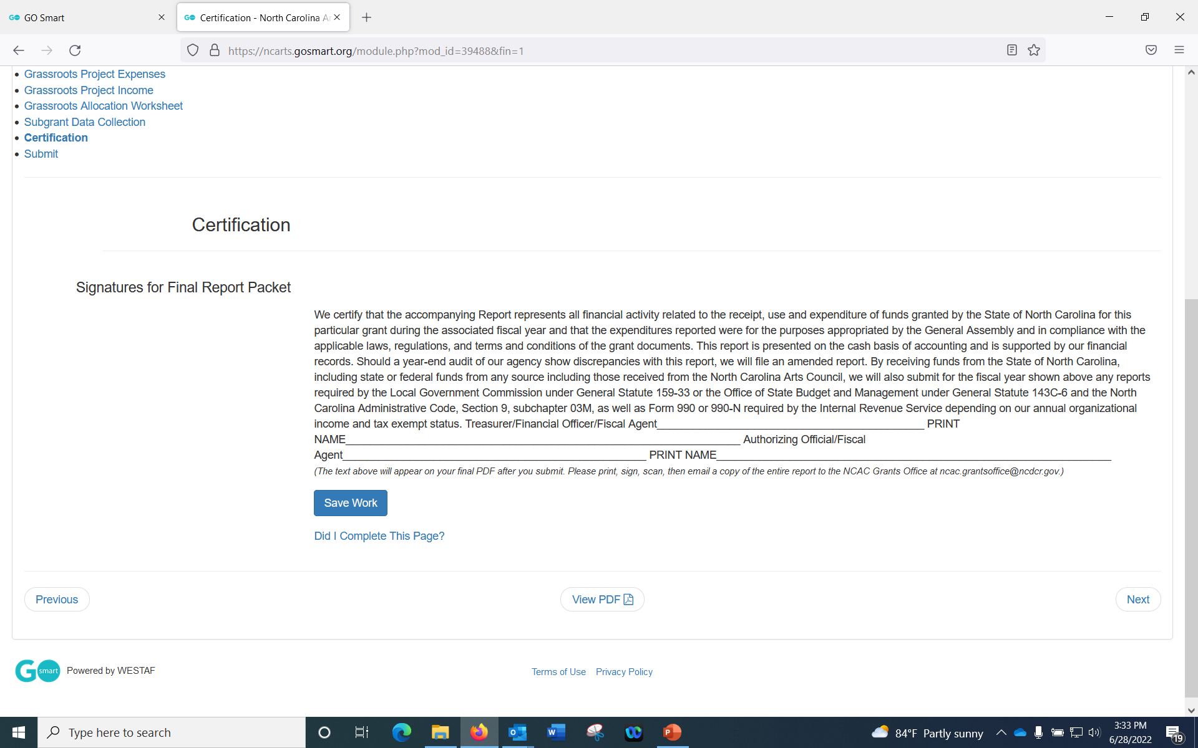
Print the report, sign it, scan the report with your signature, and email it ncac.grantsoffice@ncdcr.gov
You do not need to mail it in this year!

Slide 38
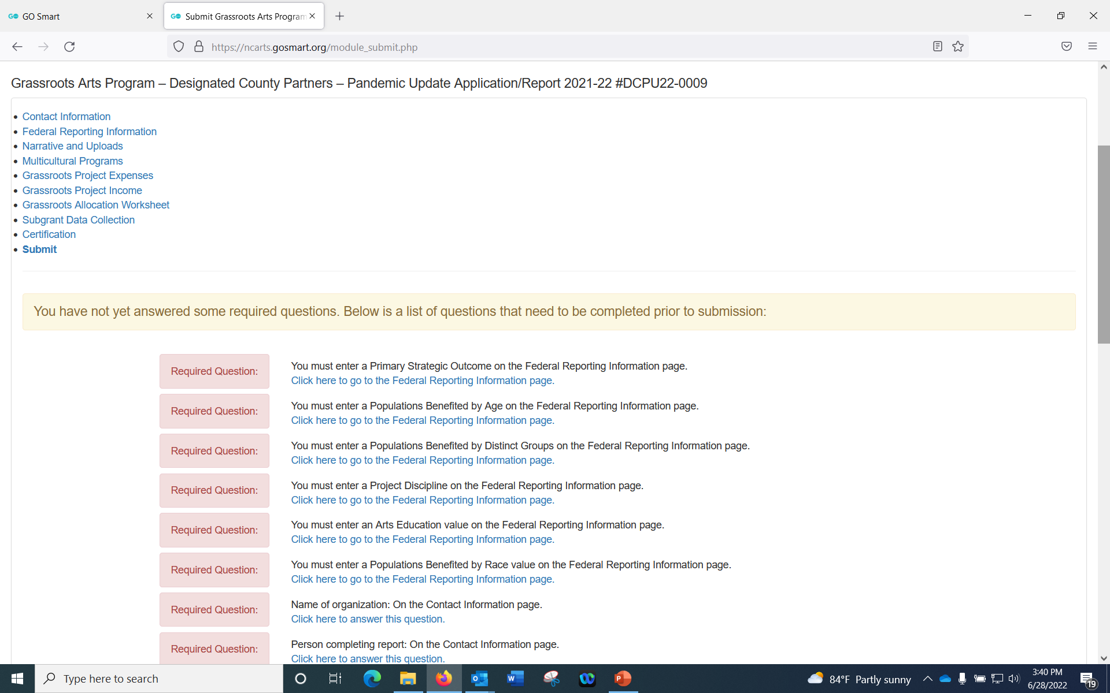

Slide 39
Common Mistakes
- Narrative does not give information about programs funded
- Budget numbers do not match the allocation worksheet
- Insufficient marketing materials (an item without our logo on it)

Slide 40
Final Checklist
- Submit your online report
Print online report and sign certification page
Ensure all uploaded documents are also included in your emailed PDF
Scan the report and email a PDF of signed report to ncac.grantsoffice@ncdcr.gov by July 31, 2022

Slide 41
Questions?
If you need help with your final report, or have specific questions, contact:
Arts in Communities Director:
Janelle Wienke
janelle.wienke@ncdcr.gov
(919) 814-6506
Creative Economies Director:
Leigh Ann Wilder
leighann.wilder@ncdcr.gov
919-814-6508

Slide 42
